Slide 1
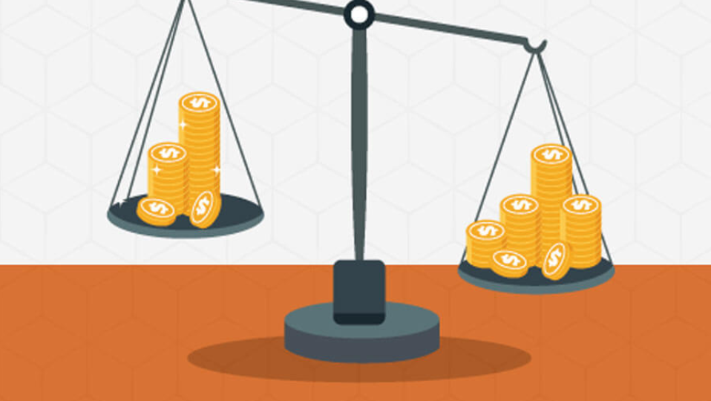
Consumer Profitability advancements by price analysis and Web Scraping in e-commerce
- NISHITA GUNJAL

Slide 2

Introduction
In this project, comparison of the price of a product from multiple eCommerce sites using Python will take place .
The main objective is to monitor the price of the specific item (or items) from multiple eCommerce platforms.
On each execution, all three websites are crawled and the product is located, and the price is obtained.

Slide 3

Existing work with limitations -
It is often seen in advertisements that there are websites which compares certain things like flight tickets (Make my Trip), policies (Policy Bazaar) and hotel rooms(Trivago) etc.
However , one of the most ordered products fall in the electronics category .
So, it is decided to create an application project which will compare the prices of a variety of electronics from a variety of brands.

Slide 4

Proposed Work And Methodology -
In this project Python programming language will be used .
The concept of web scraping will also be used .
Then Tkinter will be used to create a Graphical User Interface .

Slide 5

Novelty of the Project -
Such a web resource is intended to provide the user with key product information: its price (of course!), a brief description, availability in stores and more. Therefore, in addition to comparing prices, the consumer can also compare other important characteristics of the desired product/service.
However, these aggregators don't actually sell goods. They only collect data and product prices on different websites. To make a purchase, one needs to visit the online store itself (usually there is a link to the web resource in question).

Slide 6

Real time usage
As statistics assure us, more than 80% of users take advantage of special websites to find the cheapest prices. Such web-based aggregators are useful to all participants in the process of buying a product or ordering a service.
They help customers make affordable purchases and, on the other hand, serve as assistants to different vendors in looking for new clients.
Moreover, the owners of aggregators don't remain at a loss either. So, what we’re observing here is undeniably a classic win-win situation .

Slide 7
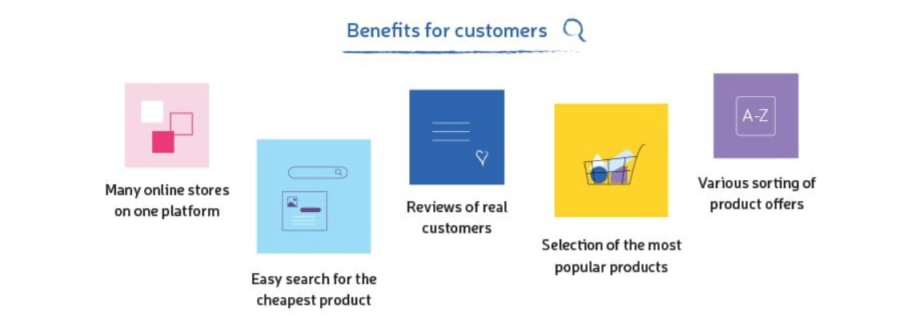
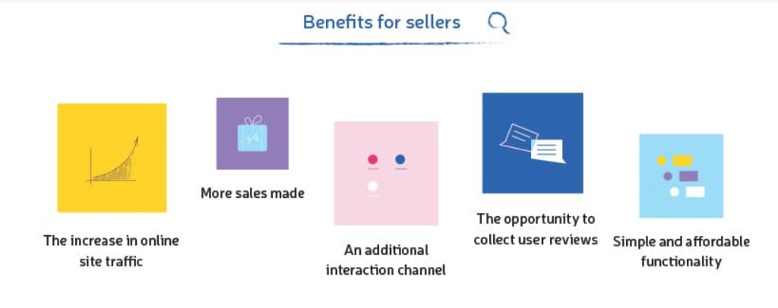

Slide 8

Software Requirements
Visual Studio Code for Python Programming will be used .
The libraries that will be used for the proposed project are mentioned below :
1. TKinter for creating a graphical user interface .
2. Beautifulsoup for retrieving the data specified in the program from the URLs(weblinks) specified by the programmer .
3. Webbrowser for web browser control .

Slide 9
Overall system architecture diagram

Slide 10
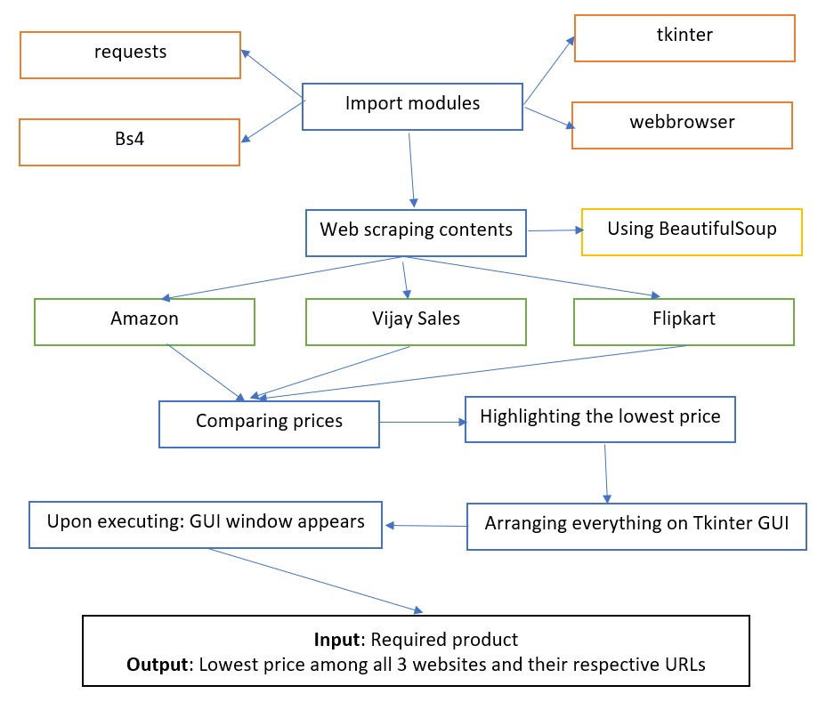

Slide 11
Module Description and Workflow Explanation

Slide 12

MODULE-1
WEB SCRAPING:--
Web scraping is the process of gathering information from the Internet.
Web scrapers work in somewhat complex ways. After all, their goal is to understand the structure of a website in order to extract the data needed and export it as a whole new format. In most cases, web scrapers will be given a specific URL (or a whole list) to scrape data from. Then the scraper will either extract all the data on the page or be able to select the specific data which will be extracted. Lastly, the scraper will run and let the user download the data as Excel sheet or other formats.

Slide 13
MODULE-2
BEAUTIFUL SOUP:--
Beautiful Soup is a Python package for parsing HTML and XML documents (including having malformed markup, i.e. non-closed tags, so named after tag soup). It creates a parse tree for parsed pages that can be used to extract data from HTML, which is useful for web scraping.
APPROACH:--
Import module
Make requests instance and pass into URL
Pass the requests into a BeautifulSoup( ) function
Then we will iterate all tags and fetch class name

Slide 14
MODULE-3
WEB BROWSER:--
It retrieves information from other parts of the web and displays it on your desktop or mobile device.
The information is transferred using the Hypertext Transfer Protocol, which defines how text, images and video are transmitted on the web.
This information needs to be shared and displayed in a consistent format so that people using any browser, anywhere in the world can see the information.
This Photo by Unknown author is licensed under CC BY-SA-NC.

Slide 15
MODULE-4
TKINTER:-
This framework provides Python users with a simple way to create GUI elements using the widgets found in the Tk toolkit. Tk widgets can be used to construct buttons, menus, data fields, etc. in a Python application.
The output window of our application uses TKinter framework.

Slide 16

Snapshot of Project

Slide 17
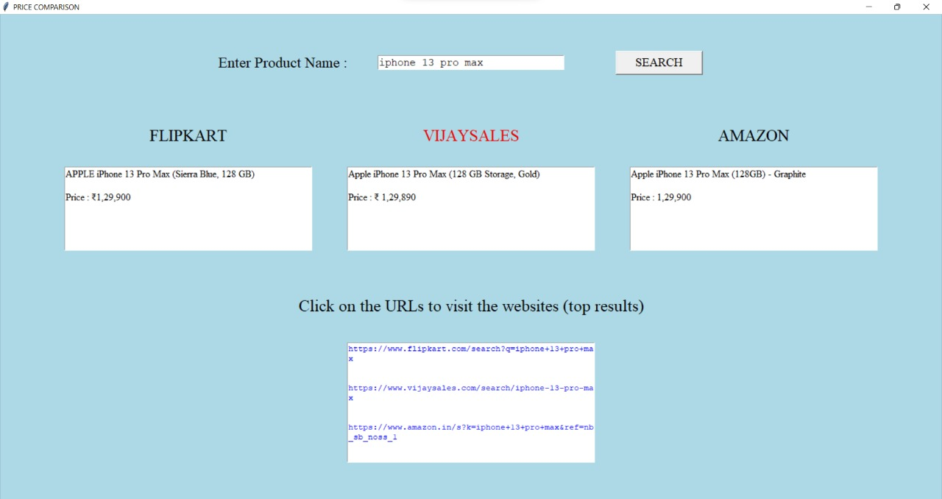

Slide 18

RESULT

Slide 19
As a result, we have got a Graphical User Interface Window , which has prices of the searched product from the 3 eCommerce websites namely Flipkart , Vijaysales and Amazon.
The GUI window also has a box where the URL's to visit the websites are provided . The URL’S will take the user to the product location and show the top results .

Slide 20


Slide 21

This project basically compares the prices of a particular product on different platforms in a way that the readers can grasp instantly.
Having a Product Comparison enables user and visitors to see if featured items or products are better than competitor companies or businesses. Thus, it results in saving time of the users.

Slide 22


